Slide 1


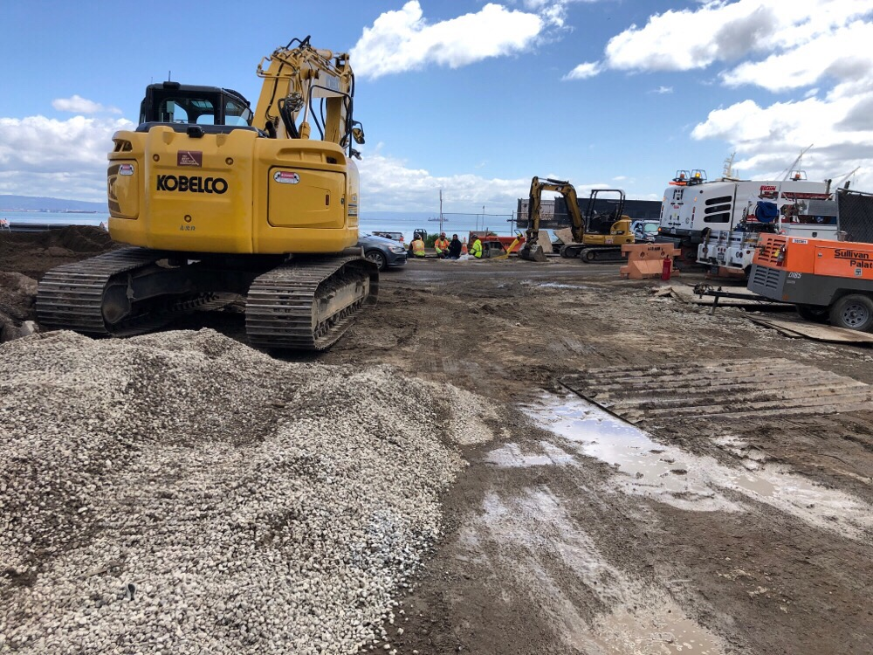



PanoFACTS
BENEFITS
Fieldwork And Compliance Tracking System
Faster reporting and
reduced monitoring cost
Automates report preparation and circulation
Increases efficiency
of personnel and tools
Integrates camera, GPS, and other
tools with the reporting process
Centralized compliance information
can be used to evaluate performance and progress
Increases report quality and database functionality
CASE STUDY
Reduces errors and inconsistencies
Leverages available smart phones and tablets
SFPUC Bay Corridor Compliance Monitoring
Panorama developed a project-specific reporting form
and integrated existing SFPUC monitoring guidelines into our proprietary PanoFACTS data collection and reporting application
Remote access to resources and compliance materials
1+ hours/week saved
in reduced labor costs for daily monitoring
Allows all team members, especially management level, to be quickly informed of project status and issues
~$10,000
annual cost savings
Increased reporting quality, functionality, and delivery speed

Slide 2


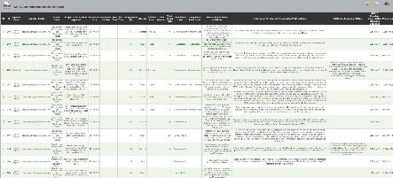
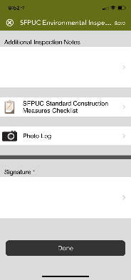
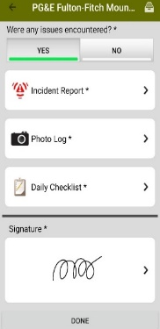
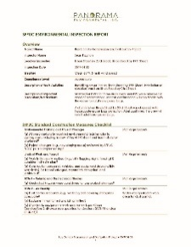


PanoFACTS
HOW IT WORKS
4
A formatted report is generated and emailed to all team members
(seconds after form submission)
1
3
Construction and compliance activities are documented in the field using a Mobile Device Form
2
Once received, the
database forwards a copy of the uploaded data to
Report Processing
Once a form is submitted,
the data uploads to the
Cloud Database

